Slide 1
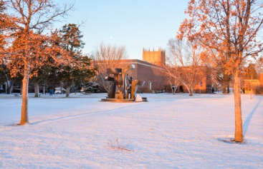
Free Will, the Bondage of the Will, and Christian Liberty
Getting some traction on this slippery subject
“Son of Man, Be Free,” sculpture by Paul Granlund on Concordia University, Nebraska campus

Slide 2
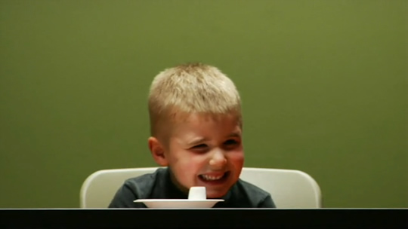
Is this free will in action?
You can eat this marshmallow right now. Or, if you wait until I come back in a few minutes and don’t eat it, then you can have a second marshmallow.
[Assorted brief videos are available on Youtube.]

Slide 3
Free Will? Or Free Won’t?
Fourteen years later, the two-marshmallows kids score 200 points higher on the SATs than do the one-marshmallow kids: “As the child’s prefrontal cortex develops, the parent’s ‘no’ becomes internalized, a basis for free will—or, rather, free won’t, our capacity to resist and manage impulse.” - Cognitive Scientist Daniel Goleman
Table Talk: So do we have free will? What evidence do you see, pro or con? How do you / we express and frame this common phrase and topic with our students?

Slide 4
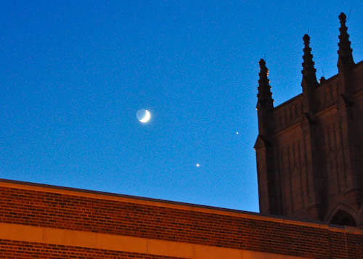
Our aim:
Free will is an enormous and important issue that has engaged artists, philosophers, scientists, novelists, and theologians for millennia.
Our aim is to consider some views and examples, check our own bearings on this key Reformation theme, and gain or review some orientation for helping our students with their usually popular but less-than-informed ideas about free will.

Slide 5
From the List-of-Ten [the user can find more on this list-of-ten at twokingdoms.cune.edu]
1. The spiritual working in, with, and under the material.
2. A Biblical anthropology
3. Two words for us: both Law and Gospel
4. Our current condition: simul iustus et peccator
5. Our alien righteousness and proper righteousness
6. God hidden and God revealed
7. A theology of the cross
8. Our Christian liberty related but not = to “free will”
9. The doctrine of vocation and priesthood of all believers
10. The two kingdoms doctrine

Slide 6
Free will as obvious? Or complicated?
Swinging at a 90 mph fastball
Your native language
Falling in love
OCD, PTSD, dyslexia, anorexia, addictions, etc.
“God has a plan for my life” and the God’s will discussion
“I can desire what is right, but I cannot do it. The good I would do, I don’t do. The evil I don’t want, I continue to do.” Rom. 7:19
“You did not choose me, but I chose and appointed you,” (Jn. 15:15) and the predestination / double predestination topic.
Theodicy, tragedy, and the problem of evil
Some other examples that come to mind: _______

Slide 7
Where does the free will discussion show up—directly or indirectly—in your work with students? (class, student life office, financial aid, coaching, etc.) Does it matter?

Slide 8
And perhaps the big one:
God’s Sovereignty
I form light and create darkness, I make well-being and create calamity, I am the LORD, who does all these things. Isa. 43:7
Our Agency and Accountability
For we must all appear before the judgment seat of Christ, so that each one may be paid back according to what he has done while in the body, whether good or evil. 2 Cor. 5:10
Wait a minute—how can God ultimately be in charge of all that happens, yet hold us responsible? No fair! Many Biblical texts and narratives affirm both God’s sovereignty and our agency.

Slide 9
Three Views on Free Will
I came to Concordia of my own free will. We all have free will, right? So it wasn’t my parents’ decision and nobody made me come. And I can just leave any time I want to. Free will, right?

Slide 10
Three Views on Free Will
I remember coming to [some earlier campus visit] here as a kid, and I just have always intended to come to Concordia. It was never really a decision. I guess I was just supposed to. I have free will, but I don’t think that really applies to this. It’s more like its God’s plan. You know what I mean?

Slide 11
Three Views on Free Will
I thought about Concordia ______, and our state university, and the financial aid. But there were other things involved, too, like being able to play volleyball, and two friends I already knew here, and being closer to home. Mom was relieved. Oh, and I liked when we visited campus. And then I just decided. So it was sorta free will, I think. Don’tcha think?

Slide 12
Three Views on Free Will
I came to Concordia of my own free will. We all have free will, right? So it wasn’t my parents’ decision and nobody made me come. And I can just leave any time I want to. Free will, right?
I remember coming to [that campus visit or…], and I just have always intended to come to Concordia. It was never really a decision. I guess I was just supposed to. I have free will, but I don’t think that really applies to this. It’s more like its God’s plan. You know what I mean?
I thought about Concordia _______, and our state university, and the financial aid. But there were other things involved, too, like being able to play volleyball, and two friends I already knew here, and being closer to home. Mom was relieved. Oh, and I liked when we visited campus. And then I just decided. So it was sorta free will, I think. Don’tcha think?

Slide 13
View #1 The Autonomous Agent
Free will is our autonomous, self-contained agency (the soul or the self) for deciding and acting: I will-and-did / I will-not-and-did-not turn over the handout on the table. Outside factors may inform my actions but, unless coerced, my choices are free from causal forces. An “I” exists who chooses. Free will is not “compatible” with causation and determinism.

Slide 14
View #1 The Autonomous Agent
Free will is our autonomous, self-contained agency (the soul or the self) for deciding and acting: I will-and-did / I will-not-and-did-not turn over the handout on the table. Outside factors may inform my actions but, unless coerced, my choices are free from causal forces. An “I” exists who chooses. Free will is not “compatible” with causation and determinism.
Problem: this view says that, unlike all other events, our choices have no causes—which is a strange view. It proposes effects independent of any causal chain (other than me alone) to explain them and that, like God, I create ex nihilo (Rom. 4:17)!

Slide 15
View #2 Determinism
Free will is an illusion. It’s the “mirror” effect of multiple brain systems working together to simplify the organism’s response to the constant and complex input of cause-and-effect chains in order to preserve the gene pool—a mirror effect now enculturated in moral and legal fictions. We all know that all events are determined by the complex causal chains that lie behind them (dominoes).

Slide 16
View #2 Determinism
Free will is an illusion. It’s the “mirror” effect of multiple brain systems working together to simplify the organism’s response to the constant and complex input of cause-and-effect chains in order to preserve the gene pool—a mirror effect now enculturated in moral and legal fictions. We all know that all events are determined by the complex causal chains that lie behind them (dominoes).
Problem: Nobody really lives this way, even those who espouse this view. This determinism or fatalism is itself an armchair fiction, a notion of scientism’s philosophical naturalism that reduces everything to billiard balls (called “reductionism”).

Slide 17
View #3 Choice + Causes
Don’t define “free will” in such extreme contrast to causality and determinism. Instead, free will simply refers to our making choices in a context of other circumstances, factors, causes and influences—that’s life—but choices that are not forced, coerced, or tricked. We take “forks in the road” every day, and we must hold ourselves and each other accountable for them through our social compacts of praising and blaming. Free choice and causal elements work together and are “compatible.”

Slide 18
View #3 Choice + Causes
Don’t define “free will” in such extreme contrast to causality and determinism. Instead, free will simply refers to our making choices in a context of other circumstances, factors, causes and influences—that’s life—but choices that are not forced, coerced, or tricked. We take “forks in the road” every day, and we must hold ourselves and each other accountable for them through our social compacts of praising and blaming. Free choice and causal elements work together and are “compatible.”
Problem: this “defining down” of free will is a pragmatic convenience that selectively ignores or blurs the serious problems of neurological and large-system causes we now are recognizing. It props up legal over-simplifications, justifies shallow praise and blame, and skirts the discussion of God’s sovereignty and omnipotence that Christians must consider.

Slide 19
Which of these 3 views do/did you
tend to favor? Which do you hear from students? Does your discipline (literature, science, etc.) or office (Student Life, admissions, etc.) tend to presume one of them?

Slide 20
The Augsburg Confession, XVIII “On Free Will”
Our churches teach that man's will has some liberty to choose civil righteousness, and for the choice of things subject to reason. But it has no power, without the Holy Spirit, to work the righteousness of God, that is, spiritual righteousness; since “the natural man receives not the things of the Spirit of God,” 1 Cor. 2,14; but this righteousness is worked in the heart when the Holy Spirit is received through the Word. (See also FC Ep Art. II and FC SD Art. II)
Not free will, then, but a will limited by sin even in civil matters and matters of reason.

Slide 21
The Re-vision from Reformation to Enlightenment
Christian liberty:
Frees us from sin, the Law, death, and the power of the devil.
Frees us to serve our neighbor rather than self according to the grace God has freely given to me.
Enlightenment liberty:
Frees us from the rule of tyrants and tradition.
Frees us to advance self-interest according to law and reason that I exercise.
Which of these do we tend to emphasize in our instruction?
Which of these do our students operate with?
Can we teach both? Do we? Is this a two-kingdoms distinction?

Slide 22
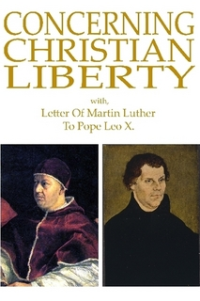
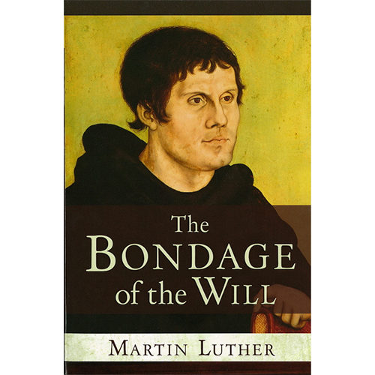
Hey, Luther, which is it? Make up your mind!
Concerning Christian Liberty is very readable. The Bondage of the Will takes a bit of work but is interesting and worth the effort.

Slide 23
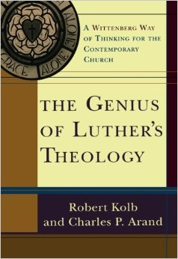
The genius of Luther’s theology is that he
recognized both Biblical themes of
God’s sovereignty—that everything happens under God’s aegis and authority (“Let God be God!”)
and
Our agency—that we are accountable and responsible to God for the lives God has given us;
did not seek to use reason to reconcile these two Biblical and self-evident truths (as philosophy has failed to do);
instead, locates their reconciliation in Christ alone (Christ is the end of the Law, Rom. 10:4);
and sustains both in creative tension for the life and formation of the Christian.
Why is Luther’s insight less than satisfactory for some people? (esp. young people?)

Slide 24
Helping Students
Pause them on:
“Well, we all have free will, right?” Uh, no, not really.
“But we have free will—you know what I mean?” No, actually, I don’t! Help me to understand what you mean.
“God has a plan for my life” and the God’s will discussion: How would you know? On what authority would you make that claim?
The LGBT, same-sex marriage, gender identity, and other instances of complex nature/nurture sin.
When tragedy occurs and the theodicy problem: saying too much, and saying too little.
“Concordia is a sheltered little bubble that treats us like children (and I’m big now and all grown up).”

Slide 25
Some Christ-and-curriculum and Christ-and-campus topics
The efficacy and ethics of torture
Mass shootings, culpability, and the legal process
LGBT, same-sex marriage, and gender identity
Muslim views about insallah, “if God wills”
Close communion, personal freedom, and community liberty
The “God has a plan for my life” and “God must be telling me…” discussions
External regulation, compliance, accreditation, assessment
The predestination topic
College adolescents free to take on long-term debt

Slide 26
Closing Slide: Luther on Youth
Youth need to be restrained and trained by the iron bars of rules and regulations [the Law] lest, in their unchecked ardor, they rush headlong into vice after vice.
On the other hand, it would be death for them always to be held in bondage to these rules, thinking that the Law justifies them.
Treatise on Christian Liberty

